Slide 1


System Load & Optimization
We will explore system load, optimization techniques, and how to identify bottlenecks.
Presenter
Mohammad Anees Alam
Notes:
1.7.2013
1
‹#›

Slide 2


Topics For today!
    Quick recap
    Analyzing system load
    Optimizing CPU & memory usage
    Debugging system bottlenecks
    Conclusion
Notes:
1.7.2013
2
‹#›

Slide 3

Quick recap …
Processes
CPU
Memory
A process is task managed by the system.
Acts as a brain to the system.
A memory is used by the system to store active data and processes.
When the system runs program, they require processing power, which the CPU provides.
We have sub-tasks within a task (process) called threads.
Sub-categories:
RAM & Swap space (Hard disk).
Notes:
1.7.2013
3
‹#›

Slide 4
Understanding CPU Usage
High CPU Usage
    High CPU usage can indicate that a program is demanding a lot of resources, which may affect the system's overall performance.
    CPU usage percentage shows how much of the CPU is being used by the processes running on the system.
    A high CPU usage (close to 100%) means that the CPU is at full capacity and may be overloaded.
Notes:
1.7.2013
4
‹#›

Slide 5
Understanding Memory Usage
RAM
Swap Space
    RAM stores active data and processes, impacting system speed.
    When RAM is full, the system uses disk space as temporary memory.
    High memory usage can cause the system to slow down, which will lead to using swap space.
    Swap space on the hard drive is used to simulate additional memory.
    However, disk access is much slower than RAM, so excessive swapping (high swap usage) can severely degrade system performance.
Notes:
1.7.2013
5
‹#›

Slide 6

Few common ways to deep-dive
Commands
Description
Observations
top
Displays system resource usage (CPU, Memory).
CPU% and MEM% - Look for processes consuming a large portion of CPU or memory.
htop
Interactive colour-coded version of top with more user-friendly display.
Observe processes that are consuming high CPU or memory. (You can use the arrow keys to scroll and interact with processes directly.)
free -h
Shows memory usage in human-readable format.
(For MAC: top, vm_stat.)
The output will show total, used, free, and swap memory in human-readable format (e.g., MB, GB).
Notes:
1.7.2013
6
‹#›

Slide 7
Exercise : Monitoring System Resources
Task:
What to Observe:
    Run the top command: Open the terminal and run top. Observe the output where the system processes are listed, and monitor the CPU and memory usage.
      To sort by Memory: Shift + M || Mac: top -o rsize
      To sort by CPU: Shift + P || Mac: top -o cpu
    CPU: In top or htop, observe the %CPU column. High CPU usage (>80%) for any process may indicate resource hogging.
    Memory: Look for memory-intensive processes in both top/htop. In free -h, if swap is used heavily (e.g., >50% of total swap), the system may be struggling with insufficient RAM.
    Run htop: Install htop if not already installed (sudo apt install htop in Linux). Run it by typing htop and observe how it presents the resource usage.
    Swap: If your swap usage is high, it could indicate that the system is running low on memory and is using disk space as a substitute, which is much slower.
    Run free -h: Execute free -h to observe memory usage.
    For Mac: vm_stat
Notes:
1.7.2013
7
‹#›

Slide 8

Load Average
Notes:
1.7.2013
8
‹#›

Slide 9

Load Average: A System's Workload
Load Average
Represents the system's workload over the past 1, 5, and 15 minutes.
Overload
A high load average indicates the system is overloaded.
1
2
3
CPU Cores
A load average less than or equal to the number of CPU cores is ideal.
Notes:
1.7.2013
9
‹#›

Slide 10
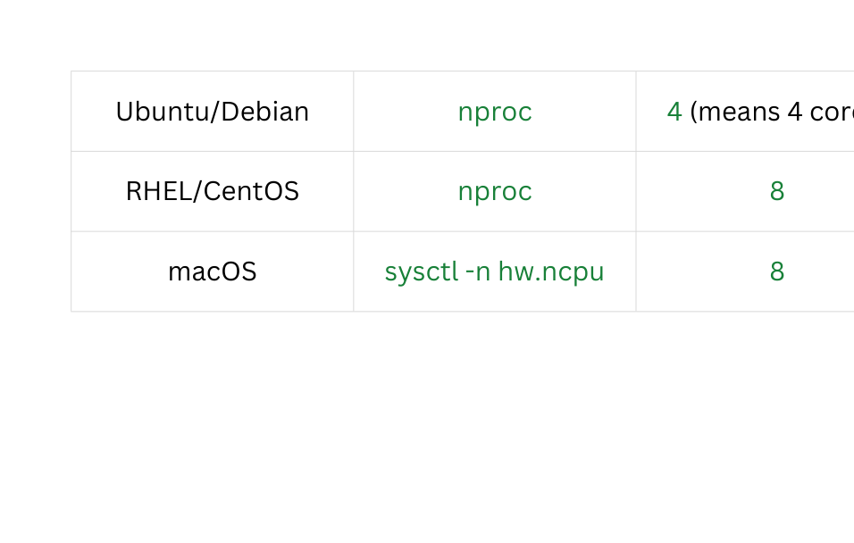
Hands-on Activity!
Checking Number of CPU Cores:
Always compare load average to CPU cores.
E.g., load avg 6.0 on a 4-core CPU = overloaded.
Run the command and analyze the load of your system: uptime

Slide 11

Context Switching: Multitasking Trade-offs
Context Switching
1
The CPU switches between tasks, a normal part of multitasking.
Performance Impact
2
High context switching can reduce efficiency, especially with many processes.
Minimizing Impact
3
Strategies include reducing the number of processes or prioritizing critical ones.
Notes:
1.7.2013
10
‹#›

Slide 12
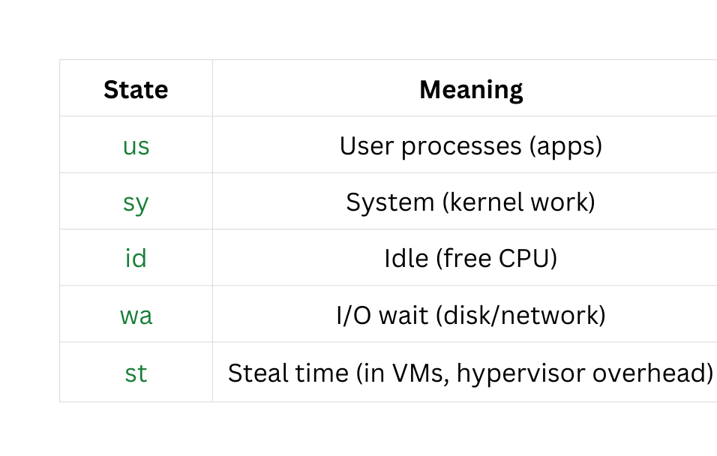
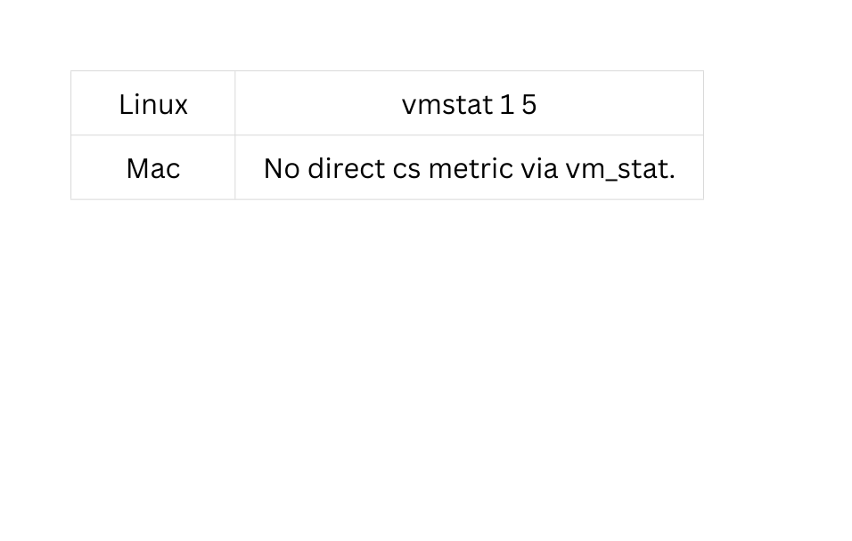
Commands
Note: You cannot see cs (context switches) natively on macOS.
CPU Usage Breakdown

Slide 13

I/O Wait
I/O wait (wa) is a CPU state that shows how much time the CPU is sitting idle waiting for disk (or sometimes network) I/O to complete.
Notes:
1.7.2013
11
‹#›

Slide 14
I/O Wait: Disk Access Bottleneck
I/O Wait
Slow Disk Access
Time spent waiting for disk operations to complete.
High I/O wait indicates slow disk access, slowing down the system.
Run the command: iostat -xz 1
  Look at the %iowait column → shows percentage of time CPU waits for I/O.
  %util column under devices → how busy the disk is.
Note:
macOS does not expose %iowait like Linux. Apple hides that metric in its kernel.
Instead, you can run: iostat -w 1
Notes:
1.7.2013
12
‹#›

Slide 15

Optimizing CPU & Memory Usage
Notes:
1.7.2013
16
‹#›

Slide 16


Resource Hogs: Identifying and Managing
Resource Hogs
Processes that consume excessive CPU or memory, slowing down the system.
Nice & Renice
    Nice: A command that starts a process with a specific priority.
    nice -n <nice_value> <command> : Range of NI: -20 (highest) to +19 (lowest)
    nice value (NI) is Positive → Low priority, Negative → High priority. {Highest priority requires sudo.}
Example:
sudo nice -n -10 top → Will launch the top command with a higher priority, meaning it will get more CPU time compared to other processes.
    Renice: Used to change the priority of an “already” running process.
    renice -n <nice_value> -p <PID> : Ex = renice -n 10 -p 1234
Notes:
1.7.2013
17
‹#›

Slide 17

Managing active processes:
Commands
Description
Observations
kill [PID]
Terminates a process by its PID
No output, the process is terminated immediately.
The terminated process will no longer appear in the process list.
nice -n <nice_value> <command>
Starts a command with a lower/higher priority
No output unless there is an error. The process starts with assigned CPU priority (higher or lower).
renice -n <nice_value> -p <PID>
Changes the priority of an existing process.
No output, the priority of the process will be updated based on what u choose.
Key point:
  renice changes the scheduler preference.
  It won’t make the process hog CPU or auto-bubble to the top of the top/htop list unless it’s actively consuming resources.
Notes:
1.7.2013
18
‹#›

Slide 18
Exercise : Adjusting Process Priority
Task:
What to Observe:
    Start a random application, pick its PID.
    renice: After running the renice command, the NI value should change.
    Use renice to change the priority of the process to highest (e.g., renice -n -20 [PID]).
    After noticing the change you can kill the PID using kill <PID> command.
    Monitor system performance using top or htop and observe the priority. { Note: It will not show at the top of the list as the prioritization depends on CPU usage.}
Notes:
1.7.2013
19
‹#›

Slide 19

Resource Allocation
Notes:
1.7.2013
20
‹#›

Slide 20



Optimal Resource Allocation
1
Efficient Utilization
Ensuring resources like CPU, memory, and disk I/O are used effectively.
Preventing overloads
2
Proper allocation prevents performance issues caused by overused or underused resources.
Continuous Monitoring
3
Regular monitoring and adjustments are needed to optimize resource utilization.
Notes:
1.7.2013
21
‹#›

Slide 21

Understanding System Bottlenecks
Bottlenecks are similar to load averages in a system.
Even the bottlenecks will indicate the reasons behind system slowing down.
    Then, what is the difference between load average & bottlenecks?
    Why use bottlenecks concept when we already have load averages?
Notes:
1.7.2013
22
‹#›

Slide 22



Understanding System Bottlenecks
CPU Bottlenecks
Memory Bottlenecks
I/O Bottlenecks
    High load average indicates the CPU is the limiting factor.
    High swap usage or low free memory suggests memory pressure.
    High I/O wait indicates slow disk access, slowing down the system.
    Happens when too many processes are trying to use the CPU, causing delays and slowdowns.
    Happens when the system has to wait longer for disk operations to complete, it leads to an I/O bottleneck.
    Happens when the system doesn’t have enough RAM to support running processes.
Notes:
1.7.2013
23
‹#›

Slide 23

SAR command to debug specific bottlenecks:
Command
Description
Observation
sar
Provides historical system performance reports.
Outputs historical CPU, memory, and I/O statistics.
Requires ''sysstat'' package, so you need to install via sudo apt/yum.
Example: sar <bottleneck_flag> <time> <No. of reports>
    sar -u 1 5 (CPU stats every 1 second, 5 times)
    sar -r 1 5 (memory stats)
    sar -d 1 5 (I/O stats)
Notes:
1.7.2013
24
‹#›

Slide 24
Recognizing Memory Issues
Swap Usage: High swap usage indicates the system is using disk space as temporary memory.
Free Memory: Low free memory and high swap usage suggest memory pressure.
Common commands used: free -h & top.
Note:
free -h is not for mac - Alternate command is vm_stat | grep "Pages free".
    Each page is a small, fixed-size block of memory that the system manages.
Notes:
1.7.2013
25
‹#›

Slide 25

Conclusion
Load Average → shows overall system demand; values above CPU cores = strain.
Bottlenecks → specific resource limits (CPU, memory, I/O) causing slowdowns.
Key Difference → load average = broad system pressure, bottlenecks = exact resource causing it.
Managing Load → monitor with tools (uptime, top, iostat, vmstat, sar).
Optimizing Performance → fix bottlenecks via hardware upgrades, tuning system/app configs, caching, or better code.
Continuous Monitoring → workloads change, so keep tracking and adjusting for sustained performance.
Notes:
1.7.2013
26
‹#›

